Slide 1



Noida Institute of Engineering and Technology, Greater Noida
Set Theory, Relations,Functions
Unit: 1
Discrete Structures
Shruti Sinha
Asst. Professor
IT
B Tech 3th Sem

Slide 2

Faculty Profile
I Shruti Sinha currently working as Assistant Professor in
NIET Greater Noida having experience of 1year and
2 months in teaching.
I have completed my Btech(CSE) as well as Mtech(AI)
from Gautam Buddha University,Greater Noida in 2020.
My area of research is Artifial Intelligence ,Machine Learning.

Slide 3
Course Objective
A course discrete structures used to represent discrete objects and relationships between these objects. These discrete structures include sets, relation , permutations, relations, graphs and trees etc.
The subject enhances one’s ability to develop logical thinking and ability to problem solving.

Slide 4
Unit 1 Objective
Use set notation, including the notations for subsets, unions, intersections, differences, complements, cross (Cartesian) products, and power sets.
Define and use the terms function, domain, codomain, range, image, inverse image (preimage), and composition.
Define and use the terms function, domain, codomain, range, image, inverse image (preimage), and composition. State the definitions of one-to-one functions (injections), onto functions (surjections), and one-to-one correspondences (bijections).
Determine which of these characteristics is associated with a given function.
Construct induction proofs involving summations, inequalities, and divisibility arguments.

Slide 5
Course Outcome
Course Outcome ( CO) | At the end of course , the student will be able to understand | Bloom’s Knowledge Level (KL)
CO1 | Write an argument using logical notation and determine if the argument is or is not valid. | K3, K4
CO2 | Understand the basic principles of sets and operations in sets. | K1, K2
CO3 | Demonstrate an understanding of relations and functions and be able to determine their properties | K3
CO4 | Demonstrate different traversal methods for trees and graphs. | K1, K4
CO5 | Model problems in Computer Science using graphs and trees. | K2, K6

Slide 6
CO-PO’s and PSO’s Mapping
 | PO1 | PO2 | PO3 | PO4 | PO5 | PO6 | PO7 | PO8 | PO9 | PO10 | PO11 | PO12
KCS303.1 | 3 | 2 | 2 | - | - | 1 | - | - | - | 1 | 1 | 3
KCS303.2 | 3 | 3 | 2 | 2 | 1 | - | - | - | - | - | 2 | 1
KCS303.3 | 3 | 3 | 2 | 1 | - | - | 3 | - | 2 | 2 | 2 | 2
KCS303.4 | 3 | 3 | 2 | 1 | - | - | 1 | - | - | 3 | 2 | 2
KCS303.5 | 3 | 3 | 2 | 1 | - | - | 3 | - | - | 1 | 3 | 3
 | PSO1 | PSO2 | PSO3 | PSO4
KCS303.1 | 1 | 2 | 3 | -
KCS303.2 | 1 | 2 | 3 | 1
KCS303.3 | 3 | 2 | 3 | 1
KCS303.4 | 2 | 3 | 3 | -
KCS303.5 | 2 | 3 | 2

Slide 7
Result Analysis
S.no | Subject name | Subject code | Result
1 | Discrete Structure | ACSE0306 | NOT YET DECLARED

Slide 8
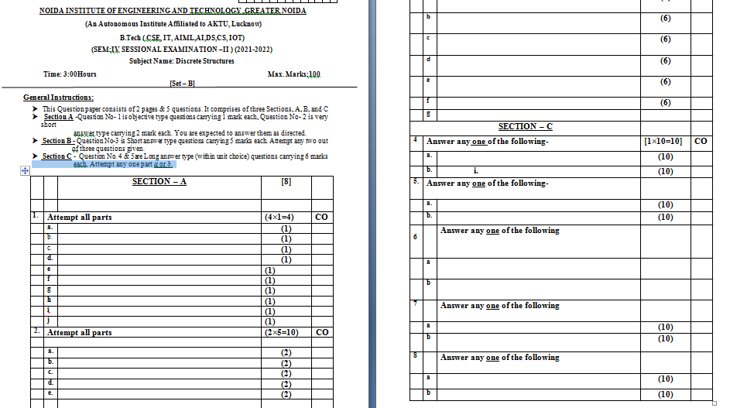
End Semester Question Paper Template

Slide 9
Topic Prerequisite
Prerequisite
Basic Understanding of class 10 mathematics NCERT.
Basic Understanding of Set Theory, Relations and Functions .
.

Slide 10
Content
Set Theory:
Sets Introduction
Types of Sets
Sets Operations
Algebra of Sets
Multisets
Inclusion-Exclusion Principle
Relations:
Binary Relation
Representation of Relations
Composition of Relations
Types of Relations
Closure Properties of Relations
Equivalence Relations

Slide 11
Content
Functions:
Types of Functions
Identity Functions
Composition of Functions
Mathematical Functions
Natural Numbers:
Mathematical Induction

Slide 12
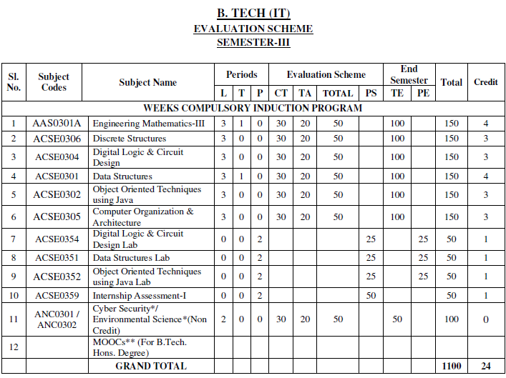
Evaluation Scheme

Slide 13
Syllabus
Unit 1
Set Theory: Introduction, Combination of sets, Multisets, Ordered pairs. Proofs of some general identities on sets. Relations: Definition, Operations on relations, Properties of relations, Composite Relations, Equality of relations, Recursive definition of relation, Order of relations.
Functions: Definition, Classification of functions, Operations on functions, Recursively defined functions. Growth of Functions.
Natural Numbers: Introduction, Mathematical Induction, Variants of Induction, Induction with Nonzero Base cases. Proof Methods, Proof by counter – example, Proof by contradiction.

Slide 14
Syllabus
Unit 2
Algebraic Structures: Definition, Groups, Subgroups and order, Cyclic Groups, Cosets, Lagrange's theorem, Normal Subgroups, Permutation and Symmetric groups, Group Homomorphisms, Definition and elementary properties of Rings and Fields.
Unit 3
Lattices: Definition, Properties of lattices – Bounded, Complemented, Modular and Complete lattice.
Boolean Algebra: Introduction, Axioms and Theorems of Boolean algebra, Algebraic manipulation of Boolean expressions. Simplification of Boolean Functions, Karnaugh maps, Logic gates, Digital circuits and Boolean algebra.

Slide 15
Syllabus
Unit 4
Propositional Logic: Proposition, well formed formula, Truth tables, Tautology, Satisfiability, Contradiction, Algebra of proposition, Theory of Inference. Predicate Logic: First order predicate, well formed formula of predicate, quantifiers, Inference theory of predicate logic.
Unit 5
Trees: Definition, Binary tree, Binary tree traversal, Binary search tree.
Graphs: Definition and terminology, Representation of graphs, Multigraphs, Bipartite graphs, Planar graphs, Isomorphism and Homeomorphism of graphs, Euler and Hamiltonian paths, Graph coloring, Recurrence Relation & Generating function: Recursive definition of functions, Recursive algorithms, Method of solving recurrences. Combinatorics: Introduction, Counting Techniques, Pigeonhole Principle

Slide 16
Discrete mathematics (CO1)
Discrete mathematics is the branch of mathematics dealing with objects that can consider only distinct, separated values. This tutorial includes the fundamental concepts of Sets, Relations and Functions, Mathematical Logic, Group theory, Counting Theory, Probability, Mathematical Induction, and Recurrence Relations, Graph Theory, Trees and Boolean Algebra.

Slide 17
Topic Objectives: Set Theory (CO1)
Sets are used to define the concepts of relations and functions. The study of geometry, sequences, probability, etc. requires the knowledge of sets.
The student will demonstrate the ability to use sets to codify mathematical object
The student will be able to:
represent a set using set-builder notation.
give examples of finite and infinite sets.
build new sets from existing sets using various combinations of the set operations intersection union, difference, and complement.
determine whether two sets are equal by determining whether each is a subset of the other

Slide 18
Introduction of Sets (CO1)
Set theory is important because it is a theory of integers, models of axiom systems, infinite ordinals, and real numbers, all in one unified structure.
The idea of set theory is to turn logical predications, like "x is less than 100 and x is greater than 1", into objects which can be manipulated by good formal rules.
A set is defined as a collection of distinct objects of the same type or class of objects. The purposes of a set are called elements or members of the set. An object can be numbers, alphabets, names, etc.
Examples of sets are:
A set of rivers of India.
A set of vowels.

Slide 19
Introduction of Sets (CO1)
We broadly denote a set by the capital letter A, B, C, etc. while the fundamentals of the set by small letter a, b, x, y, etc.
If A is a set, and a is one of the elements of A, then we denote it as a ∈ A. Here the symbol ∈ means -"Element of."

Slide 20
Sets Representation(CO1)
Sets are represented in two forms:-
a) Roster or tabular form: In this form of representation we list all the elements of the set within braces { } and separate them by commas.
Example: If A= set of all odd numbers less then 10 then in the roster from it can be expressed as A={ 1,3,5,7,9}.
b) Set Builder form: In this form of representation we list the properties fulfilled by all the elements of the set. We note as {x: x satisfies properties P}. and read as 'the set of those entire x such that each x has properties P.'
Example: If B= {2, 4, 8, 16, 32}, then the set builder representation will be:
B={x: x=2^{n}, where n ∈ N and 1≤ n ≥5}

Slide 21
Standard Notations (CO1)
x ∈ A | x belongs to A or x is an element of set A.
x ∉ A | x does not belong to set A.
∅ | Empty Set.
U | Universal Set.
N | The set of all natural numbers.
I | The set of all integers.
I₀ | The set of all non- zero integers.
I₊ | The set of all + ve integers.
C, C₀ | The set of all complex, non-zero complex numbers respectively.
Q, Q₀, Q₊ | The sets of rational, non- zero rational, +ve rational numbers respectively.
R, R₀, R₊ | The set of real, non-zero real, +ve real number respectively.

Slide 22
Cardinality (CO1)
The total number of unique elements in the set is called the cardinality of the set. The cardinality of the countably infinite set is countably infinite.
Examples:
Let P = {k, l, m, n} The cardinality of the set P is 4.
Let A is the set of all non-negative even integers, i.e. A = {0, 2, 4, 6, 8, 10......}.
As A is countably infinite set hence the cardinality.

Slide 23
Types of Sets (CO1)
Sets can be classified into many categories. Some of which are finite, infinite, subset, universal, proper, power, singleton set, etc.
Finite Sets: A set is said to be finite if it contains exactly n distinct element where n is a non-negative integer. Here, n is said to be "cardinality of sets." The cardinality of sets is denoted by|A|, # A, card (A) or n (A).
Example:
Cardinality of empty set θ is 0 and is denoted by |θ| = 0
Sets of even positive integer is not a finite set.

Slide 24
Types of Sets (CO1)
A set is called a finite set if there is one to one correspondence between the elements in the set and the element in some set n, where n is a natural number and n is the cardinality of the set. Finite Sets are also called numerable sets. n is termed as the cardinality of sets or a cardinal number of sets.
2. Infinite Sets: A set which is not finite is called as Infinite Sets.
Countable Infinite: If there is one to one correspondence between the elements in set and element in N. A countably infinite set is also known as Denumerable. A set that is either finite or denumerable is known as countable. A set which is not countable is known as Uncountable. The set of a non-negative even integer is countable Infinite.

Slide 25
Types of Sets (CO1)
Uncountable Infinite: A set which is not countable is called Uncountable Infinite Set or non-denumerable set or simply Uncountable.
Example: Set R of all +ve real numbers less than 1 that can be represented by the decimal form 0. a₁,a₂,a₃..... Where a₁ is an integer such that 0 ≤ a_{i} ≤ 9.
3. Subsets: If every element in a set A is also an element of a set B, then A is called a subset of B. It can be denoted as A ⊆ B. Here B is called Superset of A.
Example: If A= {1, 2} and B= {4, 2, 1} the A is the subset of B or A ⊆ B.

Slide 26
Types of Sets (CO1)
Properties of Subsets:
Every set is a subset of itself.
The Null Set i.e.∅ is a subset of every set.
If A is a subset of B and B is a subset of C, then A will be the subset of C. If A⊂B and B⊂ C ⟹ A ⊂ C
A finite set having n elements has 2^{n} subsets.
4. Proper Subset: If A is a subset of B and A ≠ B then A is said to be a proper subset of B. If A is a proper subset of B then B is not a subset of A, i.e., there is at least one element in B which is not in A.

Slide 27
Types of Sets (CO1)
Example:
Let A = {2, 3, 4}, B = {2, 3, 4, 5} => A is a proper subset of B.
The null ∅ is a proper subset of every set.
5. Improper Subset: If A is a subset of B and A = B, then A is said to be an improper subset of B.
Example
(i) A = {2, 3, 4}, B = {2, 3, 4} => A is an improper subset of B.
(ii) Every set is an improper subset of itself.

Slide 28
Types of Sets (CO1)
6. Universal Set: If all the sets under investigations are subsets of a fixed set U, then the set U is called Universal Set.
Example: In the human population studies the universal set consists of all the people in the world.
7. Null Set or Empty Set: A set having no elements is called a Null set or void set. It is denoted by∅.
8. Singleton Set: It contains only one element. It is denoted by {s}.
Example: S= {x|x∈N, 7<x<9} = {8}

Slide 29
Types of Sets (CO1)
9. Equal Sets: Two sets A and B are said to be equal and written as A = B if both have the same elements. Therefore, every element which belongs to A is also an element of the set B and every element which belongs to the set B is also an element of the set A.
A = B ⟺ {x ϵ A ⟺ x ϵ B}.
If there is some element in set A that does not belong to set B or vice versa then A ≠ B, i.e., A is not equal to B.
10. Equivalent Sets: If the cardinalities of two sets are equal, they are called equivalent sets.
Example: If A= {1, 2, 6} and B= {16, 17, 22}, they are equivalent as cardinality of A is equal to the cardinality of B. i.e. |A|=|B|=3

Slide 30
Types of Sets (CO1)
11. Disjoint Sets: Two sets A and B are said to be disjoint if no element of A is in B and no element of B is in A.
Example:
R = {a, b, c} S = {k, p, m}
R and S are disjoint sets.
12. Power Sets: The power of any given set A is the set of all subsets of A and is denoted by P (A). If A has n elements, then P (A) has 2^{n} elements.
Example: A = {1, 2, 3} P (A) = {∅, {1}, {2}, {3}, {1, 2}, {1, 3}, {2, 3}, {1, 2, 3}}.

Slide 31
A_{j}≠ A_{k} Then A_{j} ∩ A_{k}= ∅
Partitions of a Set (CO1)
Let S be a nonempty set. A partition of S is a subdivision of S into non-overlapping, nonempty subsets. Speceficially, a partition of S is a collection {Ai} of nonempty subsets of S such that:
Each a in S belongs to one of the Ai.
The sets of {Ai} are mutually disjoint; that is,
Aj≠ Ak Then Aj ∩ Ak= ∅
The subsets in a partition are called cells.

Slide 32
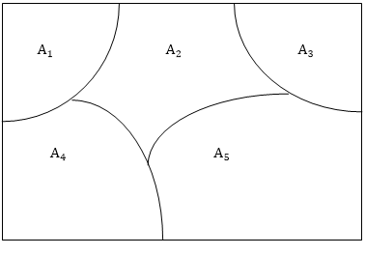
A_{j}≠ A_{k} Then A_{j} ∩ A_{k}= ∅
Partitions of a Set (CO1)
Fig: Venn diagram of a partition of the rectangular set S of points into five cells,A₁,A₂,A₃,A₄,A₅

Slide 33
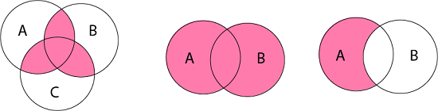
Venn Diagrams (CO1)
Venn diagram is a pictorial representation of sets in which an enclosed area in the plane represents sets.
Examples:

Slide 34
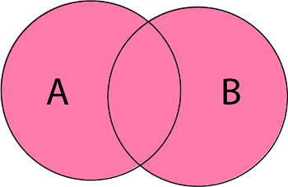
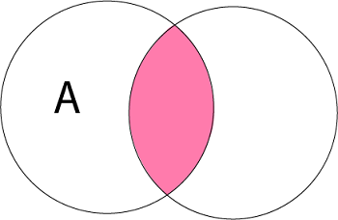
Operations on Sets (CO1)
The basic set operations are:
1. Union of Sets: Union of Sets A and B is defined to be the set of all those elements which belong to A or B or both and is denoted by A∪B.
A∪B = {x: x ∈ A or x ∈ B}
Example: Let A = {1, 2, 3}, B= {3, 4, 5, 6} A∪B = {1, 2, 3, 4, 5, 6}.
2. Intersection of Sets: Intersection of two sets A and B is the set of all those elements which belong to both A and B and is denoted by A ∩ B.
A ∩ B = {x: x ∈ A and x ∈ B}
Example: Let A = {11, 12, 13}, B = {13, 14, 15} A ∩ B = {13}.

Slide 35
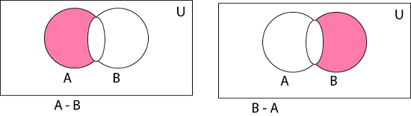
Operations on Sets (CO1)
3. Difference of Sets: The difference of two sets A and B is a set of all those elements which belongs to A but do not belong to B and is denoted by A - B.
A - B = {x: x ∈ A and x ∉ B}
Example: Let A= {1, 2, 3, 4} and B={3, 4, 5, 6} then A - B = {3, 4} and B - A = {5, 6}

Slide 36

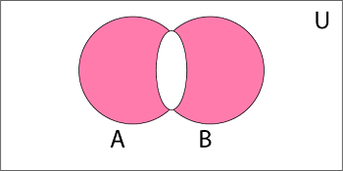
Operations on Sets (CO1)
4. Complement of a Set: The Complement of a Set A is a set of all those elements of the universal set which do not belong to A and is denoted by A^{c}.
Ac = U - A = {x: x ∈ U and x ∉ A} = {x: x ∉ A}
Example: Let U is the set of all natural numbers. A = {1, 2, 3} A^{c} = {all natural numbers except 1, 2, and 3}.
5. Symmetric Difference of Sets: The symmetric difference of two sets A and B is the set containing all the elements that are in A or B but not in both and is denoted by A ⨁ B i.e.
A ⨁ B = (A ∪ B) - (A ∩ B)
Example: Let A = {a, b, c, d} B = {a, b, l, m} A ⨁ B = {c, d, l, m}

Slide 37
Algebra of Sets (CO1)
Idempotent Laws | (a) A ∪ A = A | (b) A ∩ A = A
Associative Laws | (A ∪ B) ∪ C = A ∪ (B ∪ C) | (b) (A ∩ B) ∩ C = A ∩ (B ∩ C)
Commutative Laws | (a) A ∪ B = B ∪ A | (b) A ∩ B = B ∩ A
Distributive Laws | A ∪ (B ∩ C) = (A ∪ B) ∩ (A ∪ C) | (b) A ∩ (B ∪ C) = (A ∩ B) ∪ (A ∩ C)
De Morgan's Laws | (a) (A ∪B)^{c}=A^{c}∩ B^{c} | (b) (A ∩B)^{c}=A^{c}∪ B^{c}
Identity Laws | (a) A ∪ ∅ = A (b) A ∪ U = U | (c) A ∩ U =A (d) A ∩ ∅ = ∅
Complement Laws | (a) A ∪ A^{c}= U (b) A ∩ A^{c}= ∅ | (c) U^{c}= ∅ (d) ∅^{c} = U
Involution Law | (a) (A^{c})^{c} = A

Slide 38
Example 1: Prove Idempotent Laws (CO1)
(a) A ∪ A = A
Solution:
Since, B ⊂ A ∪ B, therefore A ⊂ A ∪ A
Let x ∈ A ∪ A ⇒ x ∈ A or x ∈ A ⇒ x ∈ A
∴ A ∪ A ⊂ A
As A ∪ A ⊂ A and A ⊂ A ∪ A ⇒ A =A ∪ A. Hence Proved.
(b) A ∩ A = A
Solution:
Since, A ∩ B ⊂ B, therefore A ∩ A ⊂ A
Let x ∈ A ⇒ x ∈ A and x ∈ A ⇒ x ∈ A ∩ A
∴ A ⊂ A ∩ A
As A ∩ A ⊂ A and A ⊂ A ∩ A ⇒ A = A ∩ A. Hence Proved.

Slide 39
Example 2: Prove Associative Laws (CO1)
(a) (A ∪ B) ∪ C = A ∪ (B ∪ C)
Solution:
Let some x ∈ (A'∪ B) ∪ C
⇒ (x ∈ A or x ∈ B) or x ∈ C
⇒ x ∈ A or x ∈ B or x ∈ C
⇒ x ∈ A or (x ∈ B or x ∈ C)
⇒ x ∈ A or x ∈ B ∪ C
⇒ x ∈ A ∪ (B ∪ C).
Similarly, if some x ∈ A ∪ (B ∪ C),
then x ∈ (A ∪ B) ∪ C.
Thus, any
x ∈ A ∪ (B ∪ C) ⇔ x ∈ (A ∪ B) ∪ C.
Hence Proved.

Slide 40
Example 2: Prove Associative Laws (CO1)
(b) (A ∩ B) ∩ C = A ∩ (B ∩ C)
Solution:
Let some x ∈ A ∩ (B ∩ C)
⇒ x ∈ A and x ∈ B ∩ C
⇒ x ∈ A and (x ∈ B and x ∈ C)
⇒ x ∈ A and x ∈ B and x ∈ C
⇒ (x ∈ A and x ∈ B) and x ∈ C)
⇒ x ∈ A ∩ B and x ∈ C
⇒ x ∈ (A ∩ B) ∩ C.
Similarly, if some x ∈ A ∩ (B ∩ C),
then x ∈ (A ∩ B) ∩ C
Thus, any
x ∈ (A ∩ B) ∩ C ⇔ x ∈ A ∩ (B ∩ C).
Hence Proved.

Slide 41
Example3: Prove Commutative Laws (CO1)
(a) A ∪ B = B ∪ A
Solution:
To Prove A ∪ B = B ∪ A
A ∪ B = {x: x ∈ A or x ∈ B} = {x: x ∈ B or x ∈ A}
(∵ Order is not preserved in case of sets)
A ∪ B = B ∪ A.
Hence Proved.
(b) A ∩ B = B ∩ A
Solution:
To Prove A ∩ B = B ∩ A
A ∩ B = {x: x ∈ A and x ∈ B} = {x: x ∈ B and x ∈ A}
(∵ Order is not preserved in case of sets)
A ∩ B = B ∩ A.
Hence Proved.

Slide 42
Example 4: Prove Distributive Laws (CO1)
(a) A ∪ (B ∩ C) = (A ∪ B) ∩ (A ∪ C)
To Prove Let x ∈ A ∪ (B ∩ C)
⇒ x ∈ A or x ∈ B ∩ C
⇒ (x ∈ A or x ∈ A) or (x ∈ B and x ∈ C)
⇒ (x ∈ A or x ∈ B) and (x ∈ A or x ∈ C)
⇒ x ∈ A ∪ B and x ∈ A ∪ C
⇒ x ∈ (A ∪ B) ∩ (A ∪ C)
Therefore, A ∪ (B ∩ C) ⊂ (A ∪ B) ∩ (A ∪ C)............(i)

Slide 43
Example 4: Prove Distributive Laws (CO1)
Again, Let y ∈ (A ∪ B) ∩ (A ∪ C)
⇒ y ∈ A ∪ B and y ∈ A ∪ C
⇒ (y ∈ A or y ∈ B) and (y ∈ A or y ∈ C)
⇒ (y ∈ A and y ∈ A) or (y ∈ B and y ∈ C)
⇒ y ∈ A or y ∈ B ∩ C
⇒ y ∈ A ∪ (B ∩ C)
Therefore, (A ∪ B) ∩ (A ∪ C) ⊂ A ∪ (B ∩ C)............(ii)
Combining (i) and (ii), we get A ∪ (B ∩ C) = (A ∪ B) ∩ (A ∪ C).
Hence Proved

Slide 44
Example 5: Prove De Morgan's Laws (CO1)
(A ∪B)^{c}=A^{c}∩ B^{c}
Solution:
To Prove (A ∪B)^{c}=A^{c}∩ B^{c}
Let x ∈ (A ∪B)^{c}
⇒ x ∉ A ∪ B (∵ a ∈ A ⇔ a ∉ A^{c})
⇒ x ∉ A and x ∉ B
⇒ x ∉ A^{c} and x ∉ B^{c}
⇒ x ∉ A^{c}∩ B^{c}
Therefore, (A ∪B)^{c} ⊂ A^{c}∩ B^{c}............. (i)

Slide 45
Example 5: Prove De Morgan's Laws (CO1)
Again, let x ∈ A^{c}∩ B^{c}
⇒ x ∈ A^{c} and x ∈ B^{c}
⇒ x ∉ A and x ∉ B
⇒ x ∉ A ∪ B
⇒ x ∈ (A ∪B)^{c}
Therefore, A^{c}∩ B^{c} ⊂ (A ∪B)^{c}............. (ii)
Combining (i) and (ii), we get A^{c}∩ B^{c} =(A ∪B)^{c}. Hence Proved.

Slide 46
Example 5: Prove De Morgan's Laws (CO1)
(b) (A ∩B)^{c} = A^{c}∪ B^{c}
Solution:
Let x ∈ (A ∩B)^{c}
⇒ x ∉ A ∩ B (∵ a ∈ A ⇔ a ∉ A^{c})
⇒ x ∉ A or x ∉ B
⇒ x ∈ A^{c} and x ∈ B^{c}
⇒ x ∈ A^{c}∪ B^{c}
∴ (A ∩B)^{c}⊂ (A ∪B)^{c}.................. (i)
Again, Let x ∈ A^{c}∪ B^{c}
⇒ x ∈ A^{c} or x ∈ B^{c}
⇒ x ∉ A or x ∉ B
⇒ x ∉ A ∩ B
⇒ x ∈ (A ∩B)^{c}
∴ A^{c}∪ B^{c}⊂ (A ∩B)^{c}.................... (ii)
Combining (i) and (ii), we get(A ∩B)^{c}=A^{c}∪ B^{c}. Hence Proved.

Slide 47
Example 6: Prove Identity Laws (CO1)
(a) A ∪ ∅ = A
Solution:
To Prove A ∪ ∅ = A
Let x ∈ A ∪ ∅
⇒ x ∈ A or x ∈ ∅
⇒ x ∈ A (∵x ∈ ∅, as ∅ is the null set )
Therefore, x ∈ A ∪ ∅ ⇒ x ∈ A
Hence, A ∪ ∅ ⊂ A.
We know that A ⊂ A ∪ B for any set B.
But for B = ∅, we have A ⊂ A ∪ ∅
From above,
A ⊂ A ∪ ∅ , A ∪ ∅ ⊂ A
⇒ A = A ∪ ∅.
Hence Proved.

Slide 48
Example 6: Prove Identity Laws (CO1)
(b) A ∩ ∅ = ∅
Solution:
To Prove A ∪ ∅ = A
Let x ∈ A ∪ ∅
⇒ x ∈ A or x ∈ ∅
⇒ x ∈ A (∵x ∈ ∅, as ∅ is the null set )
Therefore, x ∈ A ∪ ∅ ⇒ x ∈ A
Hence, A ∪ ∅ ⊂ A.
We know that A ⊂ A ∪ B for any set B.
But for B = ∅,
we have A ⊂ A ∪ ∅
From above, A ⊂ A ∪ ∅ , A ∪ ∅ ⊂ A
⇒ A = A ∪ ∅. Hence Proved.

Slide 49
Example 6: Prove Identity Laws (CO1)
(c) A ∪ U = U
Solution:
To Prove A ∪ U = U
Every set is a subset of a universal set.
∴ A ∪ U ⊆ U
Also, U ⊆ A ∪ U
Therefore, A ∪ U = U. Hence Proved.

Slide 50
Example 6: Prove Identity Laws (CO1)
(d) A ∩ U = A
Solution:
To Prove A ∩ U = A
We know A ∩ U ⊂ A................. (i)
So we have to show that A ⊂ A ∩ U
Let x ∈ A ⇒ x ∈ A and x ∈ U (∵ A ⊂ U so x ∈ A ⇒ x ∈ U )
∴ x ∈ A ⇒ x ∈ A ∩ U ∴ A ⊂ A ∩ U................. (ii)
From (i) and (ii), we get A ∩ U = A. Hence Proved.

Slide 51
Example7: Prove Complement Laws (CO1)
(c) U^{c}= ∅
Solution:
Let x ∈ U^{c} ⇔ x ∉ U ⇔ x ∈ ∅
∴ U^{c}= ∅. Hence Proved. (As U is the Universal Set).
(d) A ∩ A^{c}=∅
Solution:
As ∅ is the subset of every set
∴ ∅ ⊆ A ∩ A^{c}..................... (i)
We have to show that A ∩ A^{c} ⊆ ∅
Let x ∈ A ∩ A^{c}
⇒ x ∈ A and x ∈ A^{c}
⇒ x ∈ A and x ∉ A ⇒ x ∈ ∅ ∴ A ∩ A^{c} ⊂∅..................... (ii)
From (i) and (ii), we get A∩ A^{c}=∅. Hence Proved.

Slide 52
Example7: Prove Complement Laws (CO1)
A ∪ A^{c}= U
Solution:
To Prove A ∪ A^{c}= U
Every set is a subset of U
∴ A ∪ A^{c} ⊂ U.................. (i)
We have to show that U ⊆ A ∪ A^{c}
Let x ∈ U
⇒ x ∈ A or x ∉ A
⇒ x ∈ A or x ∈ A^{c}
⇒ x ∈ A ∪ A^{c}
∴ U ⊆ A ∪ A^{c}................... (ii)
From (i) and (ii), we get A ∪ A^{c}= U. Hence Proved.
(b) ∅^{c} = U
Solution:
Let x ∈ ∅^{c} ⇔ x ∉ ∅ ⇔ x ∈ U (As ∅ is an empty set)
∴ ∅^{c} = U. Hence Proved.

Slide 53
Example8: Prove Involution Law (CO1)
(A^{c} )^{c} =A.
Solution:
Let x ∈ (A^{c} )^{c} ⇔ x ∉ A^{c}⇔ x ∈ a
∴ (A^{c} )^{c} =A. Hence Proved.

Slide 54
Duality (CO1)
The dual E∗ of E is the equation obtained by replacing every occurrence of ∪, ∩, U and ∅ in E by ∩, ∪, ∅, and U, respectively. For example, the dual of
(U ∩ A) ∪ (B ∩ A) = A is (∅ ∪ A) ∩ (B ∪ A) = A
It is noted as the principle of duality, that if any equation E is an identity, then its dual E∗ is also an identity.

Slide 55
Principle of Extension (CO1)
According to the Principle of Extension two sets, A and B are the same if and only if they have the same members. We denote equal sets by A=B.
If A= {1, 3, 5} and B= {3, 1, 5}, then A=B i.e., A and B are equal sets.
If A= {1, 4, 7} and B= {5, 4, 8}, then A≠ B i.e.., A and B are unequal sets.

Slide 56

Cartesian product of two sets (CO1)
The Cartesian Product of two sets P and Q in that order is the set of all ordered pairs whose first member belongs to the set P and second member belong to set Q and is denoted by P x Q, i.e.,
P x Q = {(x, y): x ∈ P, y ∈ Q}
Example: Let P = {a, b, c} and Q = {k, l, m, n}. Determine the Cartesian product of P and Q.
Solution: The Cartesian product of P and Q is

Slide 57
Multisets (CO1)
A multiset is an unordered collection of elements, in which the multiplicity of an element may be one or more than one or zero. The multiplicity of an element is the number of times the element repeated in the multiset. In other words, we can say that an element can appear any number of times in a set.
Example:
A = {l, l, m, m, n, n, n, n}
B = {a, a, a, a, a, c}

Slide 58
Operations on Multisets (CO1)
1. Union of Multisets: The Union of two multisets A and B is a multiset such that the multiplicity of an element is equal to the maximum of the multiplicity of an element in A and B and is denoted by A ∪ B.
Example:
Let A = {l, l, m, m, n, n, n, n}
B = {l, m, m, m, n},
A ∪ B = {l, l, m, m, m, n, n, n, n}

Slide 59
Operations on Multisets (CO1)
2. Intersections of Multisets: The intersection of two multisets A and B, is a multiset such that the multiplicity of an element is equal to the minimum of the multiplicity of an element in A and B and is denoted by A ∩ B.
Example:
Let A = {l, l, m, n, p, q, q, r}
B = {l, m, m, p, q, r, r, r, r}
A ∩ B = {l, m, p, q, r}.

Slide 60
Operations on Multisets (CO1)
3. Difference of Multisets: The difference of two multisets A and B, is a multiset such that the multiplicity of an element is equal to the multiplicity of the element in A minus the multiplicity of the element in B if the difference is +ve, and is equal to 0 if the difference is 0 or negative
Example:
Let A = {l, m, m, m, n, n, n, p, p, p}
B = {l, m, m, m, n, r, r, r}
A - B = {n, n, p, p, p}

Slide 61
Operations on Multisets (CO1)
4. Sum of Multisets: The sum of two multisets A and B, is a multiset such that the multiplicity of an element is equal to the sum of the multiplicity of an element in A and B.
Example:
Let A = {l, m, n, p, r}
B = {l, l, m, n, n, n, p, r, r}
A + B = {l, l, l, m, m, n, n, n, n, p, p, r, r, r}

Slide 62
Operations on Multisets (CO1)
5. Cardinality of Sets: The cardinality of a multiset is the number of distinct elements in a multiset without considering the multiplicity of an element
Example:
A = {l, l, m, m, n, n, n, p, p, p, p, q, q, q}
The cardinality of the multiset A is 5.

Slide 63
Ordered Set & Ordered Pairs (CO1)
Ordered Set:
It is defined as the ordered collection of distinct objects.
Example:
Roll no {3, 6, 7, 8, 9}
Week Days {S, M, T, W, W, TH, F, S, S}

Slide 64

Ordered Set & Ordered Pairs (CO1)
Ordered Pairs
An Ordered Pair consists of two elements such that one of them is designated as the first member and other as the second member.
An ordered n-tuple is an ordered pair where the first component is an ordered (n - 1) tuples, and the n^{th} element is the second component.
{(n -1), n}
Example:

Slide 65
Topic Objectives: Relation (CO1)
To introduce relations, show their connection to sets, and their use in DBMS

Slide 66
Topic Prerequisite & Recap (CO1)
Prerequisite
Basic Understanding of class 10 mathematics NCERT.
Basic Understanding of Set Theory.
Recap
Now students are able to develop there logical thinking by using Sets concepts and use in upcoming topic. i.e. Relations

Slide 67
Binary Relation (CO1)
Whenever sets are being discussed, the relationship between the elements of the sets is the next thing that comes up. Relations may exist between objects of the same set or between objects of two or more sets.
Let P and Q be two non- empty sets. A binary relation R is defined to be a subset of P x Q from a set P to Q. If (a, b) ∈ R and R ⊆ P x Q then a is related to b by R i.e., aRb. If sets P and Q are equal, then we say R ⊆ P x P is a relation on P e.g.
(i) Let A = {a, b, c} and B = {r, s, t}
Then R = {(a, r), (b, r), (b, t), (c, s)} is a relation from A to B.
(ii) Let A = {1, 2, 3} and B = A
Then R = {(1, 1), (2, 2), (3, 3)} is a relation (equal) on A.

Slide 68
Binary Relation (CO1)
Example1: If a set has n elements, how many relations are there from A to A.
Solution: If a set A has n elements, A x A has n² elements. So, there are 2^{n2} relations from A to A.
Example2: If A has m elements and B has n elements. How many relations are there from A to B and vice versa?
Solution: There are m x n elements; hence there are 2^{m x n} relations from A to A.
Example3: If a set A = {1, 2}. Determine all relations from A to A.
Solution: There are 2²= 4 elements i.e., {(1, 2), (2, 1), (1, 1), (2, 2)} in A x A. So, there are 2⁴= 16 relations from A to A. i.e.
{(1, 2), (2, 1), (1, 1), (2, 2)}, {(1, 2), (2, 1)}, {(1, 2), (1, 1)}, {(1, 2), (2, 2)},
{(2, 1), (1, 1)},{(2,1), (2, 2)}, {(1, 1),(2, 2)},{(1, 2), (2, 1), (1, 1)}, {(1, 2),
(1, 1), (2, 2)}, {(2,1), (1, 1), (2, 2)}, {(1, 2), (2, 1), (2, 2)}, {(1, 2), (2, 1),
(1, 1), (2, 2)} and ∅.

Slide 69
Domain and Range of Relation (CO1)
Domain of Relation: The Domain of relation R is the set of elements in P which are related to some elements in Q, or it is the set of all first entries of the ordered pairs in R. It is denoted by DOM (R).
Range of Relation: The range of relation R is the set of elements in Q which are related to some element in P, or it is the set of all second entries of the ordered pairs in R. It is denoted by RAN (R).
Example:
Let A = {1, 2, 3, 4}
B = {a, b, c, d}
R = {(1, a), (1, b), (1, c), (2, b), (2, c), (2, d)}.
Solution:
DOM (R) = {1, 2}
RAN (R) = {a, b, c, d}

Slide 70
Complement of a Relation (CO1)
Consider a relation R from a set A to set B. The complement of relation R denoted by R is a relation from A to B such that
R = {(a, b): {a, b) ∉ R}.
Example:
Consider the relation R from X to Y
X = {1, 2, 3}
Y = {8, 9}
R = {(1, 8) (2, 8) (1, 9) (3, 9)}
Find the complement relation of R.
Solution:
X x Y = {(1, 8), (2, 8), (3, 8), (1, 9), (2, 9), (3, 9)}
Now we find the complement relation R from X x Y
R = {(3, 8), (2, 9)}

Slide 71
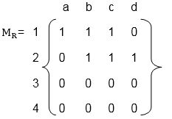
Representation of Relations (CO1)
Relations can be represented in many ways. Some of which are as follows:
Relation as a Matrix: Let P = [a₁,a₂,a₃,.......a_{m}] and Q = [b₁,b₂,b₃......b_{n}] are finite sets, containing m and n number of elements respectively. R is a relation from P to Q. The relation R can be represented by m x n matrix M = [M_{ij}], defined as
M_{ij} = 0 if ( a_{i},b_{j} ) ∉ R
1 if ( a_{i},b_{j} ) ∈ R
Example
Let P = {1, 2, 3, 4}, Q = {a, b, c, d}
and R = {(1, a), (1, b), (1, c), (2, b), (2, c), (2, d)}.
The matrix of relation R is shown as fig:

Slide 72
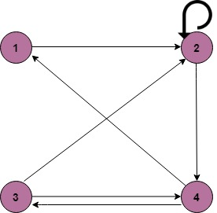
Representation of Relations (CO1)
2. Relation as a Directed Graph: There is another way of picturing a relation R when R is a relation from a finite set to itself.
Example:
A = {1, 2, 3, 4}
R = {(1, 2) (2, 2) (2, 4) (3, 2) (3, 4) (4, 1) (4, 3)}

Slide 73
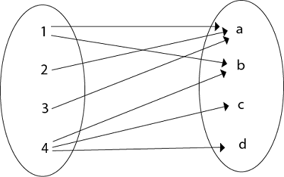
Representation of Relations (CO1)
3. Relation as an Arrow Diagram: If P and Q are finite sets and R is a relation from P to Q. Relation R can be represented as an arrow diagram as follows.
Example:
Let P = {1, 2, 3, 4}
Q = {a, b, c, d}
R = {(1, a), (2, a), (3, a), (1, b), (4, b), (4, c), (4, d)
The arrow diagram of relation R is shown in fig:

Slide 74
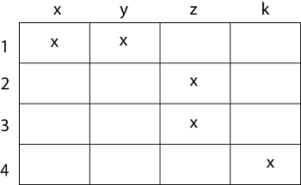
Representation of Relations (CO1)
4. Relation as a Table: If P and Q are finite sets and R is a relation from P to Q. Relation R can be represented in tabular form.
Example
Let P = {1, 2, 3, 4}
Q = {x, y, z, k}
R = {(1, x), (1, y), (2, z), (3, z), (4, k)}.
The tabular form of relation as shown in fig:

Slide 75
Composition of Relations (CO1)
Let A, B, and C be sets, and let R be a relation from A to B and let S be a relation from B to C. That is, R is a subset of A × B and S is a subset of B × C. Then R and S give rise to a relation from A to C indicated by R◦S and defined by:
a (R◦S)c if for some b ∈ B we have aRb and bSc.
is,
R ◦ S = {(a, c)| there exists b ∈ B for which (a, b) ∈ R and (b, c) ∈ S}
The relation R◦S is known the composition of R and S; it is sometimes denoted simply by RS.
Let R is a relation on a set A, that is, R is a relation from a set A to itself. Then R◦R, the composition of R with itself, is always represented. Also, R◦R is sometimes denoted by R². Similarly, R³ = R²◦R = R◦R◦R, and so on. Thus R^{n} is defined for all positive n.

Slide 76
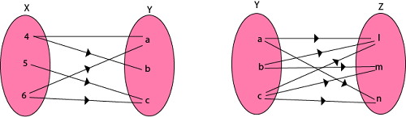
Composition of Relations (CO1)
Example1: Let X = {4, 5, 6}, Y = {a, b, c} and Z = {l, m, n}. Consider the relation R₁ from X to Y and R₂ from Y to Z.
R₁ = {(4, a), (4, b), (5, c), (6, a), (6, c)}
R₂ = {(a, l), (a, n), (b, l), (b, m), (c, l), (c, m), (c, n)}
Find the composition of relation (i) R₁ o R₂ (ii) R₁o R₁⁻¹

Slide 77
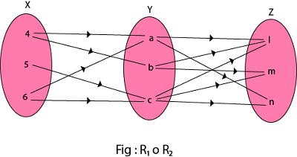
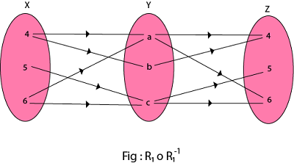
Composition of Relations (CO1)
Solution:
(i) The composition relation R₁ o R₂ as shown in fig:
R₁ o R₂ ={(4, l), (4, n), (4, m), (5, l), (5, m), (5, n), (6, l), (6, m), (6, n)}
(ii) The composition relation R₁o R₁⁻¹ as shown in fig:
R₁o R₁⁻¹ = {(4, 4), (5, 5), (5, 6), (6, 4), (6, 5), (4, 6), (6, 6)}

Slide 78
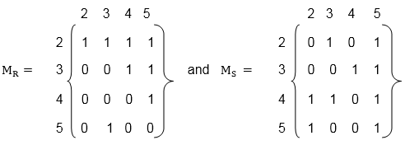
Composition of Relations and Matrices (CO1)
There is another way of finding R◦S. Let M_{R} and M_{S} denote respectively the matrix representations of the relations R and S. Then
Example:
Let P = {2, 3, 4, 5}. Consider the relation R and S on P defined by
R = {(2, 2), (2, 3), (2, 4), (2, 5), (3, 4), (3, 5), (4, 5), (5, 3)}
S = {(2, 3), (2, 5), (3, 4), (3, 5), (4, 2), (4, 3), (4, 5), (5, 2), (5, 5)}.
Find the matrices of the above relations. Use matrices to find the following composition of the relation R and S.
(i)RoS (ii)RoR (iii)SoR

Slide 79
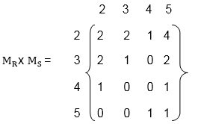
Composition of Relations and Matrices (CO1)
(i) To obtain the composition of relation R and S. First multiply M_{R} with M_{S} to obtain the matrix M_{R} x M_{S} as shown in fig:
The non zero entries in the matrix M_{R} x M_{S} tells the elements related in RoS. So,
Hence the composition R o S of the relation R and S is
R o S = {(2, 2), (2, 3), (2, 4), (3, 2), (3, 3), (4, 2), (4, 5), (5, 2), (5, 3),
(5, 4), (5, 5)}.

Slide 80
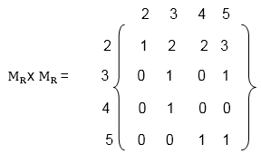
Composition of Relations and Matrices (CO1)
(ii) First, multiply the matrix M_{R} by itself, as shown in fig
Hence the composition R o R of the relation R and S is
R o R = {(2, 2), (3, 2), (3, 3), (3, 4), (4, 2), (4, 5), (5, 2), (5, 3), (5, 5)}

Slide 81
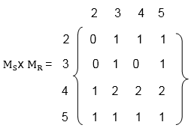
Composition of Relations and Matrices (CO1)
(iii) Multiply the matrix M_{S} with M_{R} to obtain the matrix M_{S} x M_{R} as shown in fig:
The non-zero entries in matrix M_{S} x M_{R} tells the elements related in SoR.
Hence the composition S o R of the relation S and R is
S o R = {(2, 4) , (2, 5), (3, 3), (3, 4), (3, 5), (4, 2), (4, 4), (4, 5), (5, 2), (5, 3), (5, 4), (5, 5)}.

Slide 82
Types of Relations (CO1)
1. Reflexive Relation: A relation R on set A is said to be a reflexive if (a, a) ∈ R for every a ∈ A.
Example: If A = {1, 2, 3, 4} then R = {(1, 1) (2, 2), (1, 3), (2, 4), (3, 3), (3, 4), (4, 4)}. Is a relation reflexive?
Solution: The relation is reflexive as for every a ∈ A. (a, a) ∈ R, i.e. (1, 1), (2, 2), (3, 3), (4, 4) ∈ R.
2. Irreflexive Relation: A relation R on set A is said to be irreflexive if (a, a) ∉ R for every a ∈ A.
Example: Let A = {1, 2, 3} and R = {(1, 2), (2, 2), (3, 1), (1, 3)}. Is the relation R reflexive or irreflexive?
Solution: The relation R is not reflexive as for every a ∈ A, (a, a) ∉ R, i.e., (1, 1) and (3, 3) ∉ R. The relation R is not irreflexive as (a, a) ∉ R, for some a ∈ A, i.e., (2, 2) ∈ R.

Slide 83
Types of Relations (CO1)
3. Symmetric Relation: A relation R on set A is said to be symmetric iff (a, b) ∈ R ⟺ (b, a) ∈ R.
Relation ⊥r is symmetric since a line a is ⊥r to b, then b is ⊥r to a.
Also, Parallel is symmetric, since if a line a is ∥ to b then b is also ∥ to a.
Example: Let A = {1, 2, 3} and R = {(1, 1), (2, 2), (1, 2), (2, 1), (2, 3), (3, 2)}. Is a relation R symmetric or not?
Solution: The relation is symmetric as for every (a, b) ∈ R, we have (b, a) ∈ R, i.e., (1, 2), (2, 1), (2, 3), (3, 2) ∈ R but not reflexive because (3, 3) ∉ R.

Slide 84
Types of Relations (CO1)
4. Antisymmetric Relation: A relation R on a set A is antisymmetric iff (a, b) ∈ R and (b, a) ∈ R then a = b.
Example: Let A = {1, 2, 3} and R = {(1, 1), (2, 2)}. Is the relation R antisymmetric?
Solution: The relation R is antisymmetric as a = b when (a, b) and (b, a) both belong to R.

Slide 85
Types of Relations (CO1)
5. Asymmetric Relation: A relation R on a set A is called an Asymmetric Relation if for every (a, b) ∈ R implies that (b, a) does not belong to R.
6. Transitive Relations: A Relation R on set A is said to be transitive iff (a, b) ∈ R and (b, c) ∈ R ⟺ (a, c) ∈ R.
Example1: Let A = {1, 2, 3} and R = {(1, 2), (2, 1), (1, 1), (2, 2)}. Is the relation transitive?
Solution: The relation R is transitive as for every (a, b) (b, c) belong to R, we have (a, c) ∈ R i.e, (1, 2) (2, 1) ∈ R ⇒ (1, 1) ∈ R.

Slide 86
Types of Relations (CO1)
Note1: The Relation ≤, ⊆ and / are transitive, i.e., a ≤ b, b ≤ c then a ≤ c (ii) Let a ⊆ b, b ⊆ c then a ⊆ c (iii) Let a/b, b/c then a/c
Note2: ⊥r is not transitive since a ⊥r b, b ⊥r c then it is not true that a ⊥r c. Since no line is ∥ to itself, we can have a ∥ b, b ∥ a but a ∦ a. Thus ∥ is not transitive, but it will be transitive in the plane.

Slide 87
Types of Relations (CO1)
7. Identity Relation: Identity relation I on set A is reflexive, transitive and symmetric. So identity relation I is an Equivalence Relation.
Example: A= {1, 2, 3} = {(1, 1), (2, 2), (3, 3)}
8. Void Relation: It is given by R: A →B such that R = ∅ (⊆ A x B) is a null relation. Void Relation R = ∅ is symmetric and transitive but not reflexive.
9. Universal Relation: A relation R: A →B such that R = A x B (⊆ A x B) is a universal relation. Universal Relation from A →B is reflexive, symmetric and transitive. So this is an equivalence relation.

Slide 88
Closure Properties of Relations (CO1)
Consider a given set A, and the collection of all relations on A. Let P be a property of such relations, such as being symmetric or being transitive. A relation with property P will be called a P-relation. The P-closure of an arbitrary relation R on A, indicated P (R), is a P-relation such that
R ⊆ P (R) ⊆ S
(1) Reflexive and Symmetric Closures: The next theorem tells us how to obtain the reflexive and symmetric closures of a relation easily.
Theorem: Let R be a relation on a set A. Then:
R ∪ ∆_{A} is the reflexive closure of R
R ∪ R⁻¹ is the symmetric closure of R.

Slide 89
Closure Properties of Relations (CO1)
Example1: Let A = {k, l, m}. Let R is a relation on A defined by
R = {(k, k), (k, l), (l, m), (m, k)}.
Find the reflexive closure of R.
Solution: R ∪ ∆ is the smallest relation having reflexive property,
Hence, R_{F} = R ∪ ∆ = {(k, k), (k, l), (l, l), (l, m), (m, m), (m, k)}.
Example2: Consider the relation R on A = {4, 5, 6, 7} defined by
R = {(4, 5), (5, 5), (5, 6), (6, 7), (7, 4), (7, 7)}
Find the symmetric closure of R.
Solution:
The smallest relation containing R having the symmetric property is R ∪ R⁻¹,i.e. R_{S} = R ∪ R⁻¹ =
{(4, 5), (5, 4), (5, 5), (5, 6), (6, 5), (6, 7), (7, 6), (7, 4), (4, 7), (7, 7)}.

Slide 90
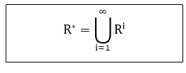
Closure Properties of Relations (CO1)
(2)Transitive Closures: Consider a relation R on a set A. The transitive closure R of a relation R of a relation R is the smallest transitive relation containing R.
Recall that R² = R◦ R and R^{n} = R^{n-1} ◦ R. We define
The following Theorem applies:
Theorem1: R* is the transitive closure of R
Suppose A is a finite set with n elements.
R* = R ∪R² ∪.....∪ R^{n}
Theorem 2: Let R be a relation on a set A with n elements. Then
Transitive (R) = R ∪ R²∪.....∪ R^{n}

Slide 91
Closure Properties of Relations (CO1)
Example1: Consider the relation R = {(1, 2), (2, 3), (3, 3)} on A = {1, 2, 3}. Then R² = R◦ R = {(1, 3), (2, 3), (3, 3)} and R³ = R² ◦ R = {(1, 3), (2, 3), (3, 3)} Accordingly, Transitive (R) = {(1, 2), (2, 3), (3, 3), (1, 3)}

Slide 92
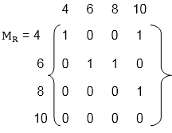
Closure Properties of Relations (CO1)
Example1: Consider the relation R = {(1, 2), (2, 3), (3, 3)} on A = {1, 2, 3}. Then R² = R◦ R = {(1, 3), (2, 3), (3, 3)} and R³ = R² ◦ R = {(1, 3), (2, 3), (3, 3)} Accordingly, Transitive (R) = {(1, 2), (2, 3), (3, 3), (1, 3)}
Example2: Let A = {4, 6, 8, 10} and R = {(4, 4), (4, 10), (6, 6), (6, 8),
(8, 10)} is a relation on set A. Determine transitive closure of R.
Solution: The matrix of relation R is shown in fig:

Slide 93
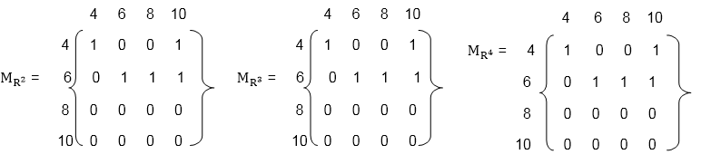
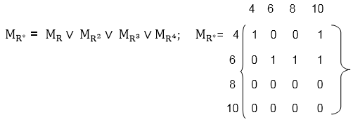
Closure Properties of Relations (CO1)
Now, find the powers of M_{R} as in fig:
Hence, the transitive closure of M_{R} is M_{R}* as shown in Fig (where M_{R}* is the ORing of a power of M_{R})
Thus, R* = {(4, 4), (4, 10), (6, 8), (6, 6), (6, 10), (8, 10)}

Slide 94
Warshall’s Algorithm: Key Ideas (CO1)
In any set A with |A|=n, any transitive relation will be built from a sequence of relations that has a length of at most n. Why?
Consider the case where the relation R on A has the ordered pairs (a₁,a₂),(a₂,a₃),…,(a_{n-1},a_{n}). Then, (a₁,a_{n}) must be in R for R to be transitive
Thus, by the previous theorem, it suffices to compute (at most) R^{n}
Recall that R^{k}=R^{ο}R^{k-1} is computed using a bit-matrix product
The above gives us a natural algorithm for computing the transitive closure: the Warshall’s Algorithm

Slide 95
Warshall’s Algorithm (CO1)
Input: An (n×n) 0-1 matrix M_{R} representing a relation R on A, |A|=n
Output: An (n×n) 0-1 matrix W representing the transitive closure of R on A
1. W← M_{R}
2. For k=1,…, n Do
For i=1,…,n Do
For j=1,…,n Do
w_{i,j} ← w_{i.j} ∨ (w_{i,k} ∧ w_{k,j})
End
End
End
Return W

Slide 96
Warshall’s Algorithm (CO1)
Example: Compute the transitive closure of the relation
R={(1,1),(1,2),(1,4),(2,2),(2,3),(3,1), (3,4),(4,1),(4,4)}
on the set A={1,2,3,4}.

Slide 97
Equivalence Relation (CO1)
Consider the set of every person in the world
Now consider a R relation such that (a,b)∈R if a and b are siblings.
Clearly this relation is
Reflexive
Symmetric, and
Transitive
Such as relation is called an equivalence relation.
Definition: A relation on a set A is an equivalence relation if it is reflexive, symmetric, and transitive
Example: Let R={ (a,b) | a,b∈R and a≤b}
Is R reflexive?
Is it transitive?
Is it symmetric?
No, it is not. 4 is related to 5 (4 ≤ 5) but 5 is not related to 4
Thus R is not an equivalence relation

Slide 98
Equivalence Class (CO1)
Although a relation R on a set A may not be an equivalence relation, we can define a subset of A such that R does become an equivalence relation (on the subset)
Definition: Let R be an equivalence relation on a set A and let a ∈A. The set of all elements in A that are related to a is called the equivalence class of a. We denote this set [a]_{R}. We omit R when there is not ambiguity as to the relation.
[a]_{R} = { s | (a,s)∈R, s∈A}
The elements in [a]_{R} are called representatives of the equivalence class

Slide 99
Equivalence Class (CO1)
Theorem: Let R be an equivalence class on a set A. The following statements are equivalent
aRb
[a]=[b]
[a] ∩[b] ≠∅
The proof in the book is a circular proof

Slide 100
Examples (CO1)
Example1: Let R={ (a,b) | a,b∈Z and a=b}
Is R reflexive?
Is it transitive?
Is it symmetric?
What are the equivalence classes that partition Z?
Example2: For (x,y),(u,v) ∈R², we define
R={ ((x,y),(u,v)) | x²+y²=u²+v²}
Show that R is an equivalence relation.
What are the equivalence classes that R defines (i.e., what are the partitions of R²)?

Slide 101
Examples (CO1)
Example3: Given n,r∈N, define the set nZ + r = { na + r | a ∈Z }
For n=2, r=0, 2Z represents the equivalence class of all even integers
What n, r give the class of all odd integers?
For n=3, r=0, 3Z represents the equivalence class of all integers divisible by 3
For n=3, r=1, 3Z represents the equivalence class of all integers divisible by 3 with a remainder of 1
In general, this relation defines equivalence classes that are, in fact, congruence classes.

Slide 102
Topic Objectives: Function (CO1)
Objectives – The student will be able to:
use the composition of logarithms and the floor or ceiling functions to solve problems.
calculate values for iterated function sequences for various choices of a₀.
give complete or partial arrow diagrams for iterated functions.
use algebraic methods to locate all cycles of length 1 and length 2 for given functions.
use the principle of mathematical induction to prove that a given sequence eventually reaches one of several cycles.

Slide 103
Topic Prerequisite & Recap (CO1)
Prerequisite
Basic Understanding of class 10 mathematics NCERT.
Basic Understanding of Set Theory & Relations.
Recap
Now students are able to develop there logical thinking by using
Sets and Relations concepts and use in upcoming topic. i.e. Functions.

Slide 104
Functions (CO1)
A Function assigns to each element of a set, exactly one element of a related set. Functions find their application in various fields like representation of the computational complexity of algorithms, counting objects, study of sequences and strings, to name a few.
It is a mapping in which every element of set A is uniquely associated at the element with set B. The set of A is called Domain of a function and set of B is called Co domain.
Domain of a Function: Let f be a function from P to Q.
The set P is called the domain of the function f.
Co-Domain of a Function: Let f be a function from P to Q.
The set Q is called Co-domain of the function f.

Slide 105
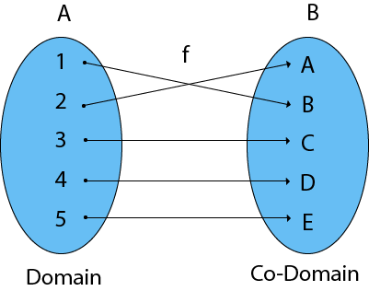
Functions (CO1)
Range of a Function: The range of a function is the set of picture of its domain. In other words, we can say it is a subset of its co-domain. It is denoted as f (domain).
If f: P → Q, then f (P) = {f(x): x ∈ P} = {y: y ∈ Q | ∃ x ∈ P, such that f (x) = y}.

Slide 106
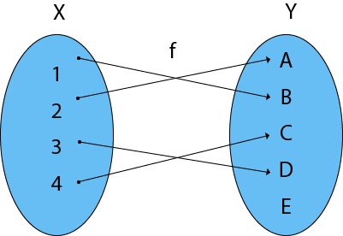
Example (CO1)
Example: Find the Domain, Co-Domain, and Range of function.
Let x = {1, 2, 3, 4}
y = {a, b, c, d, e}
f = {(1, b), (2, a), (3, d), (4, c)
Solution:
Domain of function: {1, 2, 3, 4}
Range of function: {a, b, c, d}
Co-Domain of function: {a, b, c, d, e}

Slide 107
Functions (CO1)
Definition: A function f from set A to set B, denoted f: A→B, is an assignment of each element of A to exactly one element of B.
We write f(a) = b if b is the unique element of B assigned to the element a of A.
Students
Grades
Functions are also called mappings
A
Jay
B
Vijay
C
Ajay
D
F
Sanjay

Slide 108
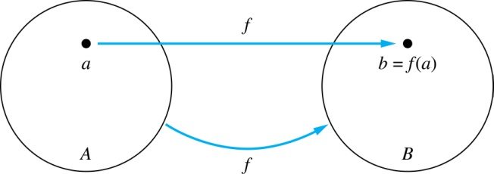
Functions (CO1)
Given a function f: A → B
A is called the domain of f
B is called the codomain of f
f is a mapping from A to B
If f(a) = b
then b is called the image of a under f
a is called the preimage of b
The range (or image) of f is the set of all images of points in A. We denote it by f(A).

Slide 109
Example (CO1)
A
B
The domain of f is A
The codomain of f is B
The image of b is y
f(b) = y
The preimage of y is b
The preimage of z is {a,c,d}
The range/image of A is {y,z}
f(A) = {y,z}
a
x
b
y
c
d
z

Slide 110
Representing Functions (CO1)
Functions may be specified in different ways:
An explicit statement of the assignment.
Students and grades example.
A formula.
f(x) = x + 1
A computer program.
A Java program that when given an integer n, produces the nth Fibonacci Number

Slide 111
Injections (CO1)
Definition: A function f is one-to-one, or injective, iff a ≠ b implies that f(a) ≠ f(b) for all a and b in the domain of f.
A
B
a
x
v
b
y
c
z
d
w

Slide 112
Surjections (CO1)
Definition: A function f from A to B is called onto or surjective, iff for every element b ∈ B there exists an element a ∈ A with f(a) = b
A
B
a
x
b
y
c
z
d

Slide 113
Bijections (CO1)
Definition: A function f is a one-to-one correspondence, or a bijection, if it is both one-to-one and onto (surjective and injective)
A
B
a
x
b
y
c
d
z
w

Slide 114
Showing that f is/is not injective or surjective (CO1)
Consider a function f: A → B
f is injective iff:
∀x,y ∈ A ( x ≠ y → f(x) ≠ f(y) )
f is not injective iff:
∃x,y ∈ A ( x ≠ y ∧ f(x) = f(y) )
f is surjective iff:
∀y ∈ B ∃x ∈ A ( f(x) = y )
f is not surjective iff:
∃y ∈ B ∀x ∈ A (f(x) ≠ b)

Slide 115
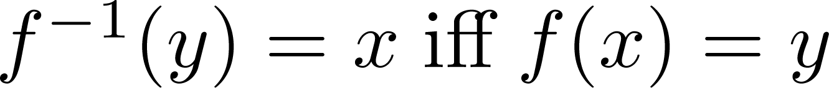
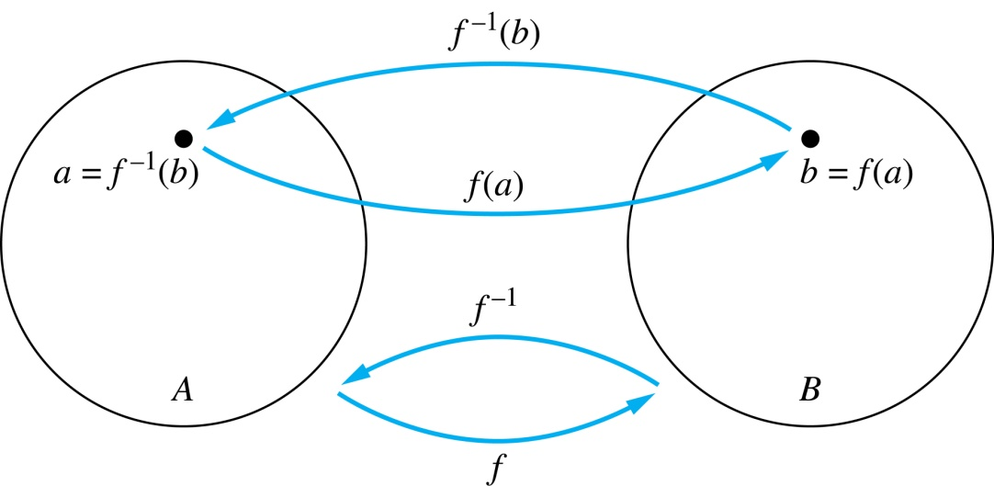
Inverse Functions (CO1)
Definition: Let f be a bijection from A to B. Then the inverse of f, denoted f ^{–1}, is the function from B to A defined as
No inverse exists unless f is a bijection.

Slide 116
Inverse Functions (CO1)
Example 1:
Let f be the function from {a,b,c} to {1,2,3}
f(a)=2, f(b)=3, f(c)=1.
Is f invertible and if so what is its inverse?
Solution:
f is invertible because it is a bijection
f ^{–1} reverses the correspondence given by f:
f ^{–1}(1)=c, f ^{–1}(2)=a, f ^{–1}(3)=b.

Slide 117
Inverse Functions (CO1)
Example 2:
Let f: R → R be such that f(x) = x²
Is f invertible, and if so, what is its inverse?
Solution:
The function f is not invertible because it is not one-to-one

Slide 118
Inverse Functions (CO1)
Example 3:
Let f: Z → Z be such that f(x) = x + 1
Is f invertible and if so what is its inverse?
Solution:
The function f is invertible because it is a bijection
f ^{–1} reverses the correspondence:
f ^{–1}(y) = y – 1

Slide 119
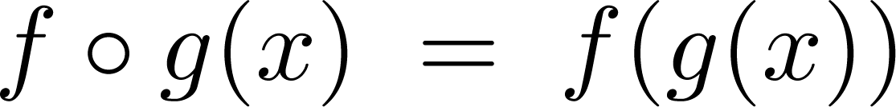
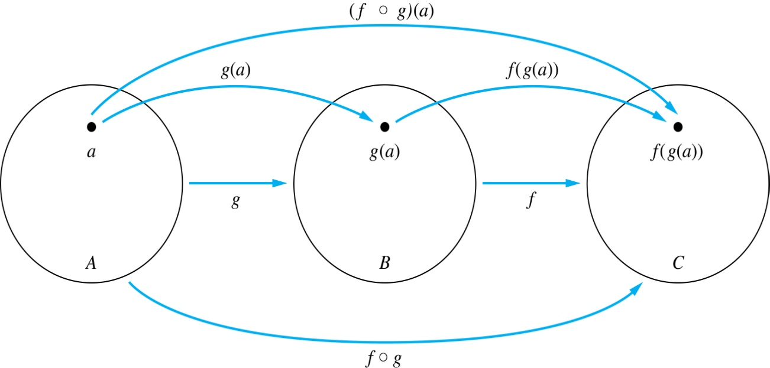
Composition (CO1)
Definition: Let f: B → C, g: A → B. The composition of f with g, denoted f ∘ g is the function from A to C defined by

Slide 120
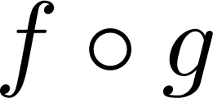
Composition (CO1)
A
g
B
f
C
A
C
a
v
a
h
h
b
i
b
i
w
c
c
x
j
j
d
d
y

Slide 121
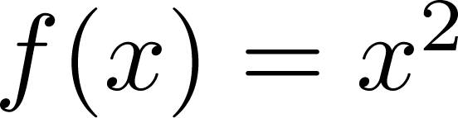
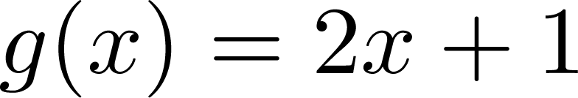
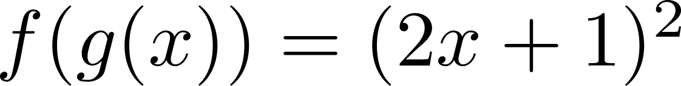
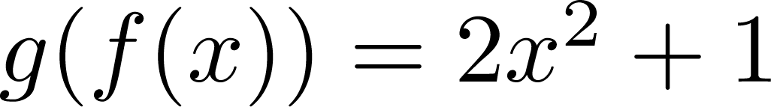
Composition (CO1)
Example: If and then
and

Slide 122
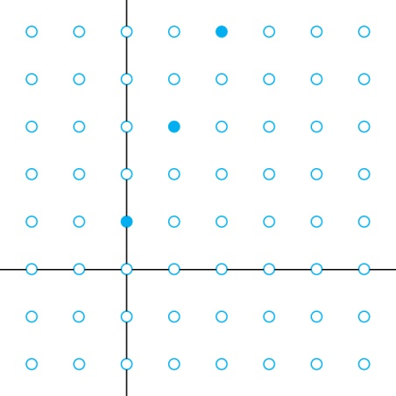
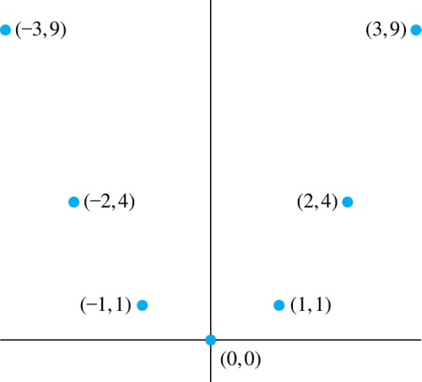
Graphs of Functions (CO1)
Let f be a function from the set A to the set B. The graph of the function f is the set of ordered pairs
{(a,b) | a ∈A and f(a) = b}
Graph of f(n) = 2n+1
from Z to Z
Graph of f(x) = x²
from Z to Z

Slide 123
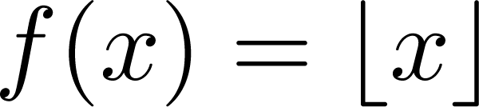
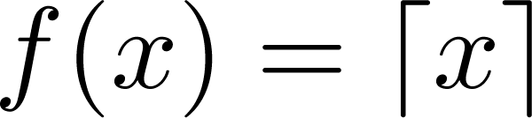
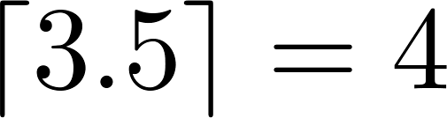
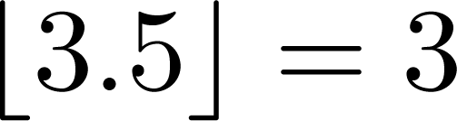
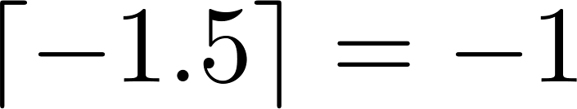
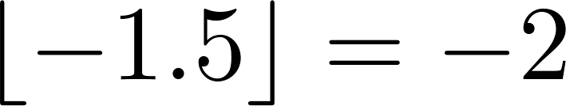
Some Important Functions (CO1)
The floor function, denoted
is the largest integer less than or equal to x.
The ceiling function, denoted
is the smallest integer greater than or equal to x
Examples:

Slide 124
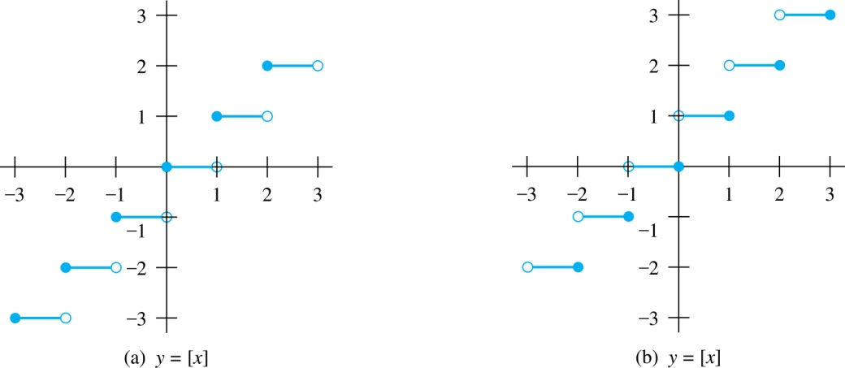
Some Important Functions (CO1)
Floor Function (≤x) Ceiling Function (≥x)

Slide 125
Factorial Function (CO1)
Definition: f: N → Z⁺, denoted by f(n) = n! is the product of the first n positive integers:
f(n) = 1 ∙ 2 ∙∙∙ (n–1) ∙ n for n>0
f(0) = 0! = 1
Examples:
f(1) = 1! = 1
f(2) = 2! = 1 ∙ 2 = 2
f(6) = 6! = 1 ∙ 2 ∙ 3 ∙ 4 ∙ 5 ∙ 6 = 720
f(20) = 2,432,902,008,176,640,000

Slide 126
Topic Objective: Mathematical Induction (CO1)
The principle of mathematical induction is one such tool which can be used to prove a wide variety of mathematical statements.
The student will demonstrate the ability to use iterative and recursive processes to prove properties of integers.
The student will be able to
write a direct proof for a simple implication involving basic properties of integers (like “even” and “odd”).
use the principle of mathematical induction to prove a summation satisfies a given closed formula
recognize various forms of proof (direct proof, proof by contrapositive, proof by cases, proof by exhaustion, proof by mathematical induction, proof by contradiction, existence proof).

Slide 127
Recap
Prerequisite
Basic Understanding of class 10 mathematics NCERT.
Basic Understanding of Set Theory, Relations and Functions .
Recap
Now students are able to develop there logical thinking by using Sets, Relations and Functions concepts and use in upcoming topic. i.e. Mathematical Induction

Slide 128
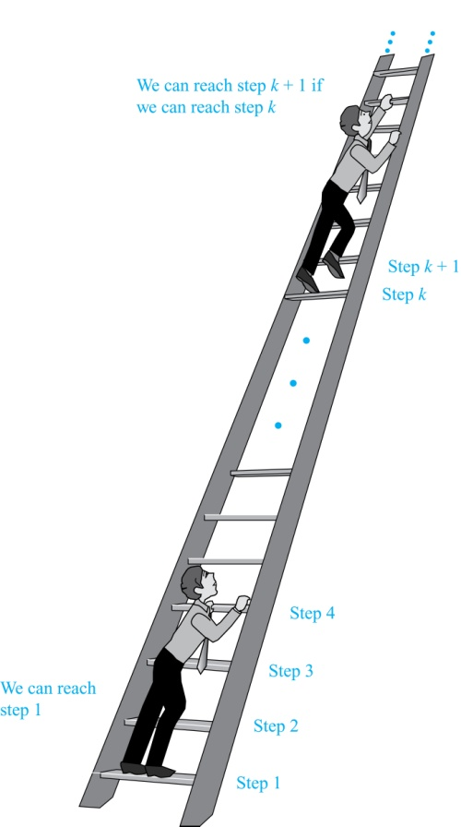
Mathematical Induction (CO1)
Discrete mathematics is more concerned with number systems such as the integers, whole numbers, etc...
Mathematical Induction is a mathematical technique which is used to prove a statement, a formula or a theorem is true for every natural number.
Climbing an Infinite Ladder
Suppose we have an infinite ladder:
We can reach the first rung of the ladder.
If we can reach a particular rung of the ladder, then we can reach the next rung.
Can we reach every step on the ladder?

Slide 129
Principle of Mathematical Induction (CO1)
Principle of Mathematical Induction: To prove that P(n) is true for all positive integers n, we complete these steps:
Basis Step: Show that P(1) is true.
Inductive Step: Show that P(k) → P(k + 1) is true for all positive integers k.
To complete the inductive step, assuming the inductive hypothesis that P(k) holds for an arbitrary integer k, show that must P(k + 1) be true.
Climbing an Infinite Ladder Example:
BASIS STEP: By (1), we can reach rung 1.
INDUCTIVE STEP: Assume the inductive hypothesis that we can reach rung k. Then by (2), we can reach rung k + 1.
Hence, P(k) → P(k + 1) is true for all positive integers k. We can reach every rung on the ladder.

Slide 130
Important Points (CO1)
Mathematical induction can be expressed as the rule of inference
(P(1) ∧ ∀k (P(k) → P(k + 1))) → ∀n P(n),
where the domain is the set of positive integers.
In a proof by mathematical induction, we don’t assume that P(k) is true for all positive integers! We show that if we assume that P(k) is true, then P(k + 1) must also be true.
Proofs by mathematical induction do not always start at the integer 1. In such a case, the basis step begins at a starting point b where b is an integer.
Mathematical induction is valid because of the well ordering property

Slide 131
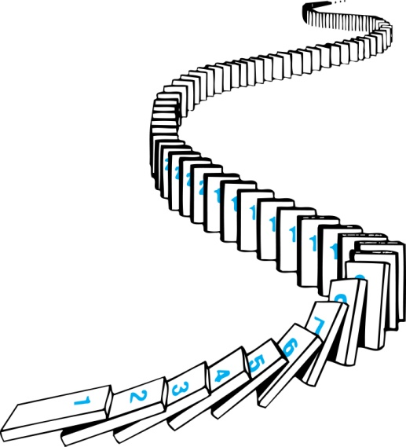
How Mathematical Induction Works (CO1)
Consider an infinite sequence of dominoes, labeled 1,2,3, …, where each domino is standing.
Let P(n) be the proposition that the n^{th} domino is knocked over.
know that the first domino is knocked down, i.e., P(1) is true.
We also know that if whenever the k^{th} domino is knocked over, it knocks over the (k + 1)^{st} domino, i.e, P(k) → P(k + 1) is true for all positive integers k.
Hence, all dominos are knocked over.
P(n) is true for all positive integers n.

Slide 132
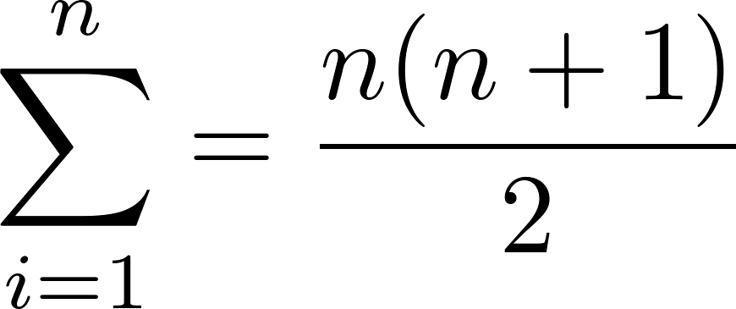
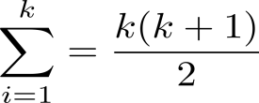
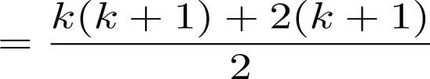
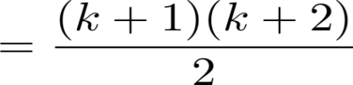

Examples (CO1)
Example: Show that: for all positive integers.
Solution:
BASIS STEP: P(1) is true since 1(1 + 1)/2 = 1.
INDUCTIVE STEP: Assume true for P(k).
The inductive hypothesis is
Under this assumption,
Hence, we have shown that P(k + 1) follows from P(k). Therefore the sum of the first n positive integers is

Slide 133
Example (CO1)
Example: Use mathematical induction to show that 1 + 2 + 2² +· · ·+2^{k} = 2^{n+1} − 1 for all nonnegative integers n.
Solution:
P(n): 1 + 2 + 2² +· · ·+2^{k} = 2^{n+1} − 1 for all nonnegative integers n
BASIS STEP: P(0) is true since 2⁰ = 1 = 2¹ − 1. This completes the basis step.
INDUCTIVE STEP: assume that P(k) is true for an arbitrary nonnegative integer k
1 + 2 + 2² +· · ·+2^{k} = 2^{k+1} − 1.
show that assume that P(k) is true, then P(k + 1) is also true.
1 + 2 + 2² +· · ·+2^{k} + 2^{k+1} = 2^{(k+1)+1} − 1 = 2^{k+2} − 1
Under the assumption of P(k), we see that
1 + 2 + 2² +· · ·+2^{k} + 2^{k+1} = (1 + 2 + 2² +· · ·+2^{k}) + 2^{k+1}=(2^{k+1} − 1) + 2^{k+1} = 2 · 2^{k+1} − 1= 2^{k+2} − 1.
Because we have completed the basis step and the inductive step, by mathematical induction we know that P(n) is true for all nonnegative integers n. That is, 1 + 2+· · ·+2^{n} = 2^{n+1} − 1 for all nonnegative integers n.

Slide 134
Examples (CO1)
Example: Conjecture and prove correct a formula for the sum of the first n positive odd integers. Then prove your conjecture.
Solution:
We have:
1= 1,
1 + 3 = 4,
1 + 3 + 5 = 9,
1 + 3 + 5 + 7 = 16,
1 + 3 + 5 + 7 + 9 = 25.
We can conjecture that the sum of the first n positive odd integers is n²,
1 + 3 + 5 + ∙∙∙+ (2n − 1) + (2n + 1) =n² .

Slide 135
Examples (CO1)
P(n):1 + 3 + 5 + ∙∙∙+ (2n − 1) + (2n + 1) =n² .
BASIS STEP: P(1) is true since 1² = 1.
INDUCTIVE STEP: P(k) → P(k + 1) for every positive integer k.
Assume the inductive hypothesis holds and then show that P(k) holds has well.
So, assuming P(k), it follows that:
Hence, we have shown that P(k + 1) follows from P(k). Therefore the sum of the first n positive odd integers is n².
Inductive Hypothesis: 1 + 3 + 5 + ∙∙∙+ (2k − 1) =k²
1 + 3 + 5 + ∙∙∙+ (2k − 1) + (2k + 1) =[1 + 3 + 5 + ∙∙∙+ (2k − 1)] + (2k + 1)
= k² + (2k + 1)
= k² + 2k + 1
= (k + 1) ²

Slide 136
Examples (CO1)
Example: Use mathematical induction to prove that 2^{n} < n!, for every integer n ≥ 4.
Solution:
Let P(n) be the proposition that 2^{n} < n!.
BASIS STEP: P(4) is true since 2⁴ = 16 < 4! = 24.
INDUCTIVE STEP: Assume P(k) holds, i.e., 2^{k} < k! for an arbitrary integer k ≥ 4.
To show that P(k + 1) holds:
2^{k+1} = 2∙2^{k}
< 2∙ k! (by the inductive hypothesis)
< (k + 1)k!
= (k + 1)!
Therefore, 2^{n} < n! holds, for every integer n ≥ 4.

Slide 137
Examples (CO1)
Example: Use mathematical induction to show that if S is a finite set with n elements, where n is a nonnegative integer, then S has 2^{n} subsets.
Solution:
P(n) be the proposition that a set with n elements has 2^{n} subsets.
Basis Step: P(0) is true, because the empty set has only itself as a subset and 2⁰ = 1.
Inductive Step: Assume P(k) is true for an arbitrary nonnegative integer k. Inductive Hypothesis: For an arbitrary nonnegative integer k, every set with k elements has 2^{k} subsets.
Let T be a set with k + 1 elements. Then T = S ∪ {a}, where a ∈ T and S = T− {a}.

Slide 138
Examples (CO1)
For each subset X of S, there are exactly two subsets of T, i.e., X and X ∪ {a}.
By the inductive hypothesis S has 2^{k} subsets. Since there are two subsets of T for each subset of S, the number of subsets of T is 2 ∙2^{k} = 2^{k+1} .
Because we have completed the basis step and the inductive step, by mathematical induction if S is a finite set with n elements, where n is a nonnegative integer, then S has 2^{n} subsets.

Slide 139

Algorithm (CO1)

Slide 140
Faculty Video Links, Youtube & NPTEL Video Links and Online Courses Details (CO1)
Youtube/other Video Links
https://www.youtube.com/watch?v=9AUCdsmBGmA&list=PL0862D1A947252D20&index=10 CO1
https://www.youtube.com/watch?v=7k4Di5u-oUU&list=PL0862D1A947252D20&index=12 CO1
https://www.youtube.com/watch?v=_BIKq9Xo_5A&list=PL0862D1A947252D20&index=13 CO1

Slide 141
Daily Quiz (CO1)
The number of elements in the Power set P(S) of the set S = [ [ Φ] ,
1, [ 2, 3 ]] is
A.2 B.4
C.8 D.None of these
2. If A and B are sets and A∪ B= A ∩ B, then
A.A = Φ B.B = Φ
C.A = B D.none of these
3. Let S be an infinite set and S₁, S₂, S₃, ..., S_{n} be sets such that S₁ ∪S₂ ∪S₃∪ .......S_{n} = S then
A.atleast one of the sets S_{i} is a finite set
B.not more than one of the set S_{i} can be inite
C.atleast one of the sets S_{i} is an ininite set
D.none of these

Slide 142
Daily Quiz (CO1)
4. A __________ is an ordered collection of objects. a) Relation b) Function c) Set d) Proposition
5. The set O of odd positive integers less than 10 can be expressed by _____________ a) {1, 2, 3} b) {1, 3, 5, 7, 9} c) {1, 2, 5, 9} d) {1, 5, 7, 9, 11}
6. Power set of empty set has exactly _________ subset. a) One b) Two c) Zero d) Three
7. What is the Cartesian product of A = {1, 2} and B = {a, b}? a) {(1, a), (1, b), (2, a), (b, b)} b) {(1, 1), (2, 2), (a, a), (b, b)} c) {(1, a), (2, a), (1, b), (2, b)} d) {(1, 1), (a, a), (2, a), (1, b)}

Slide 143
Daily Quiz (CO1)
8. The set of positive integers is _____________ a) Infinite b) Finite c) Subset d) Empty
9. How many binary relations are there on a set S with 9 distinct elements? a) 2⁹⁰ b) 2¹⁰⁰ c) 2⁸¹ d) 2⁶⁰
10. _____ number of reflexive relations are there on a set of 11 distinct elements. a) 2¹¹⁰ b) 3¹²¹ c) 2⁹⁰ d) 2¹³²
11. The number of symmetric relations on a set with 15 distinct elements is ______ a) 2¹⁹⁶ b) 2⁵⁰ c) 2³²⁰ d) 2⁷⁸

Slide 144
Daily Quiz (CO1)
12. Suppose S is a finite set with 7 elements. How many elements are there in the largest equivalence relation on S? a) 56 b) 78 c) 49 d) 100
13. _____ is the rank of the largest equivalence relation on a set of 20 elements. a) 3²⁰ b) 2⁴⁰⁰ c) 20 d) 1
14. How many elements are there in the smallest equivalence relation on a set with 8 elements? a) 10² b) 8 c) 48 d) 32

Slide 145
Daily Quiz (CO1)
15. The rank of smallest equivalence relation on a set with 12 distinct elements is _______ a) 12 b) 144 c) 136 d) 79
16. Synonym for binary relation is _______ a) equivalence relation b) dyadic relation c) orthogonal relation d) one to many relation
17. Let A and B be any two arbitrary events then which one of the
following is true ?
a) P( A intersection B) = P(A). P(B) b)P(A union B) = P(A) + P(B)
c)P(AB) = P(A intersection B). P(B) d)P(A union B) >= P(A) + P(B)

Slide 146
Daily Quiz (CO1)
15. Domain of a function is : a) the maximal set of numbers for which a function is defined b) the maximal set of numbers which a function can take values c) it is set of natural numbers for which a function is defined d) none of the mentioned
16. Range of a function is : a) the maximal set of numbers for which a function is defined b) the maximal set of numbers which a function can take values c) it is set of natural numbers for which a function is defined d) none of the mentioned
17. State whether the given statement is true or false Codomain is the subset of range. a) True b) False

Slide 147
Daily Quiz (CO1)
18. In the principle of mathematical induction, which of the following steps is mandatory? a) induction hypothesis b) inductive reference c) induction set assumption d) minimal set representation
19. For m = 1, 2, …, 4m+2 is a multiple of ________ a) 3 b) 5 c) 6 d) 2
20. For any integer m>=3, the series 2+4+6+…+(4m) can be equivalent to ________ a) m²+3 b) m+1 c) m^{m} d) 3m²+4

Slide 148
Weekly Assignment (CO1)
1.Let A={a,{a}}. Determine whether the following statements are true or false.
a. {a,{a}} ε P(A) b. {a,{a}} ⊆ P(A) c. {{a}} ε P(A) d.{{a}} ⊆ P(A)
2. Let U={0,1,2,3,4,5,6,7} and A = {0,2,4,6} , B={1,3,5,7} C = {0, 3,6}
3. Find (i) A U B (ii) A ∩ B (iii) B’ (iv) A-B
4. Prove that if A, B and C are three sets.
i) A U (BUC) =(AUB)UC
ii)A-(B∩C) = (A-B) U(A-C)
iii) A∩(B-C) = (A∩B) – (A∩C)
5. A= {1,2,3} , B={ 4,5}, C={ 1,2,3,4,5}.Find (i) A X B (ii) C X B (iii) B X B
6. Prove that( (A -B)XC) = (AXC)-(AXB).

Slide 149
Weekly Assignment (CO1)
7. Let two function f and g from +ve integers to +ve integers defined by f(x) = x² and g(x) = 2^{x} Find fog(x), gog(x) , fog(x) and gof(x)?
8. Let two function f and g from R⁺ to R⁺ defined as f(x) = 2x and g(x) = x² +2x-3. Find gog(x) and gof(x)?
9. Consider a function f:A→B and g:B→C. Prove that if f and g are one to one and onto then gof is one-to-one and onto (gof)⁻¹ = f⁻¹og⁻¹
10. Let f:R→R be defined by f(x) = 6x-17.
11. Use the definition of Ackermann function to find A(1,3).
12. Prove that following by using mathematical induction
a. n! = 2^{n-1} for n>= 1
b.7^{n}-2^{n} is divisible by 5
c.1.2+2.2²+………………+n.2^{n} = (n-1) 2^{n+1}+ 2
13. What is recursively defined function. Give the definition of factorial

Slide 150
Weekly Assignment (CO1)
1.Let A={a,{a}}. Determine whether the following statements are true or false.
a. {a,{a}} ε P(A) b. {a,{a}} ⊆ P(A) c. {{a}} ε P(A) d.{{a}} ⊆ P(A)
2. Let U={0,1,2,3,4,5,6,7} and A = {0,2,4,6} , B={1,3,5,7} C = {0, 3,6}
3. Find (i) A U B (ii) A ∩ B (iii) B’ (iv) A-B
4. Prove that if A, B and C are three sets.
i) A U (BUC) =(AUB)UC
ii)A-(B∩C) = (A-B) U(A-C)
iii) A∩(B-C) = (A∩B) – (A∩C)
5. A= {1,2,3} , B={ 4,5}, C={ 1,2,3,4,5}.Find (i) A X B (ii) C X B (iii) B X B
6. Prove that( (A -B)XC) = (AXC)-(AXB).

Slide 151
MCQs(CO1)
For any integer m>=3, the series 2+4+6+…+(4m) can be equivalent to ________ a) m²+3 b) m+1 c) m^{m} d) 3m²+4
For every natural number k, which of the following is true? a) (mn)^{k} = m^{k}n^{k} b) m*k = n + 1 c) (m+n)^{k} = k + 1 d) m^{k}n = mn^{k}
For any positive integer m, ______ is divisible by 4. a) 5m² + 2 b) 3m + 1 c) m² + 3 d) m³ + 3m
Which of the following is the base case for 4^{n+1} > (n+1)² where n = 2? a) 64 > 9 b) 16 > 2 c) 27 < 91 d) 54 > 8

Slide 152
MCQs(CO1)
5.R is a binary relation on a set S and R is reflexive if and only if _______ a) r(R) = R b) s(R) = R c) t(R) = R d) f(R) = R
6. If R₁ and R₂ are binary relations from set A to set B, then the equality ______ holds. a) (R^{c})^{c} = R^{c} b) (A x B)^{c} = Φ c) (R₁ U R₂)^{c} = R₁^{c} ∪ R₂^{c} d) (R₁ U R₂)^{c} = R₁^{c} ∩ R₂^{c}
^{7.} The condition for a binary relation to be symmetric is _______ a) s(R) = R b) R ∪ R = R c) R = R^{c} d) f(R) = R

Slide 153
MCQs(CO1)
8.______ number of reflexive closure exists in a relation R = {(0,1), (1,1), (1,3), (2,1), (2,2), (3,0)} where {0, 1, 2, 3} ∈ A. a) 2⁶ b) 6 c) 8 d) 36
9. The transitive closure of the relation {(0,1), (1,2), (2,2), (3,4), (5,3), (5,4)} on the set {1, 2, 3, 4, 5} is _______ a) {(0,1), (1,2), (2,2), (3,4)} b) {(0,0), (1,1), (2,2), (3,3), (4,4), (5,5)} c) {(0,1), (1,1), (2,2), (5,3), (5,4)} d) {(0,1), (0,2), (1,2), (2,2), (3,4), (5,3), (5,4)}
10. Amongst the properties {reflexivity, symmetry, antisymmetry, transitivity} the relation R={(a,b) ∈ N² | a!= b} satisfies _______ property. a) symmetry b) transitivity c) antisymmetry d) reflexivity

Slide 154
MCQs(CO1)
11. The number of equivalence relations of the set {3, 6, 9, 12, 18} is ______ a) 4 b) 2⁵ c) 22 d) 90
12. Let R₁ and R₂ be two equivalence relations on a set. Is R₁ ∪ R₂ an equivalence relation? a) an equivalence relation b) reflexive closure of relation c) not an equivalence relation d) partial equivalence relation
13. A relation R is defined on the set of integers as aRb if and only if a+b is even and R is termed as ______ a) an equivalence relation with one equivalence class b) an equivalence relation with two equivalence classes c) an equivalence relation d) an equivalence relation with three equivalence classes

Slide 155
MCQs(CO1)
14. The binary relation U = Φ (empty set) on a set A = {11, 23, 35} is _____ a) Neither reflexive nor symmetric b) Symmetric and reflexive c) Transitive and reflexive d) Transitive and symmetric
15. The binary relation {(1,1), (2,1), (2,2), (2,3), (2,4), (3,1), (3,2)} on the set {1, 2, 3} is __________ a) reflective, symmetric and transitive b) irreflexive, symmetric and transitive c) neither reflective, nor irreflexive but transitive d) irreflexive and antisymmetric
16. Consider the relation: R’ (x, y) if and only if x, y>0 over the set of non-zero rational numbers,then R’ is ______ a) not equivalence relation b) an equivalence relation c) transitive and asymmetry relation d) reflexive and antisymmetric relation

Slide 156
MCQs(CO1)
17.Consider the binary relation, A = {(a,b) | b = a – 1 and a, b belong to {1, 2, 3}}. The reflexive transitive closure of A is: a) {(a,b) | a >= b and a, b belong to {1, 2, 3}} b) {(a,b) | a > b and a, b belong to {1, 2, 3}} c) {(a,b) | a <= b and a, b belong to {1, 2, 3}} d) {(a,b) | a = b and a, b belong to {1, 2, 3}}
18. Let A and B be two non-empty relations on a set S. Which of the following statements is false? a) A and B are transitive ⇒ A∩B is transitive b) A and B are symmetric ⇒ A∪B is symmetric c) A and B are transitive ⇒ A∪B is not transitive d) A and B are reflexive ⇒ A∩B is reflexive

Slide 157
MCQs(CO1)
19. Determine the characteristics of the relation aRb if a² = b². a) Transitive and symmetric b) Reflexive and asymmetry c) Trichotomy, antisymmetry, and irreflexive d) Symmetric, Reflexive, and transitive
20. Let R be a relation between A and B. R is asymmetric if and only if ________ a) Intersection of D(A) and R is empty, where D(A) represents diagonal of set b) R⁻¹ is a subset of R, where R⁻¹ represents inverse of R c) Intersection of R and R⁻¹ is D(A) d) D(A) is a subset of R, where D(A) represents diagonal of set

Slide 158
Old Question Papers(CO1)
1. Prove that (A∪ B) ∩ C =A∪( B ∩ C) if an only if A ⊆ C.
2. Show that (A-B) ∩ (B-A) = ɸ
3. Find the transitive closure of the relation R = {(3,3), (2,2), (1, 3), (2,
1)} on A = {1, 2, 3, 4}.
4. Let A is a set with 10 distinct elements. Describe the following:-
(i) No. of different binary relations on A.
(ii) No. of different symmetric relations on A.
5. Define various types of functions.
6. Write the difference between Relation and function.
A={1,2,3….13}. Consider the equivalence relation on A*A defined by (a,b)R(c,d) if a+d=b+c. Find equivalence class of (5,8).

Slide 159
Old Question Papers(CO1)
8. Prove that by mathematical induction 8+88+888+…..88888…8(n digits)=8(10^{n+1}-9n-10)/81,
where n is natural number.
9. Prove by induction that for all integers n>= 4, 3^{n}> n^{3.}.
10. Prove the following by principle of mathematical induction ∀n ∈N, Product of two consecutive natural number is even.
11. Prove by mathematical induction, sum of finite number of terms of geometric progression: a+ar+ar²+…………+ar^{n}….= (ar^{n+1} –a)/(r-1) when r≠ 1

Slide 160
Old Question Papers (CO1)
For some more Old Question Papers visit the link below.
https://drive.google.com/drive/folders/1LBqJvyWPNRCdAcr9Sag4TzECfnLgRIQn?usp=sharing

Slide 161
GLOSSARY QUESTIONS
1.Determine in how many ways can three gifts be shared among 4 boys in the following conditions-
i) No one gets more than one gift.
ii) A boy can get any number of gifts.
2.Find the sum of all four-digit numbers formed by using 2, 3, 6, 9 in which no digit is repeated.
3.The members of the set S = {x | x is the square of an integer and x < 100} is ________________ a) {0, 2, 4, 5, 9, 58, 49, 56, 99, 12} b) {0, 1, 4, 9, 16, 25, 36, 49, 64, 81} c) {1, 4, 9, 16, 25, 36, 64, 81, 85, 99} d) {0, 1, 4, 9, 16, 25, 36, 49, 64, 121}
4.The set of positive integers is _____________ a) Infinite b) Finite c) Subset d) Empty
5.What is the Cardinality of the Power set of the set {0, 1, 2}? a) 8 b) 6 c) 7 d) 9

Slide 162
Expected Questions for University Exam(CO1)
1. How many symmetric and reflexive relations are possible from a set A
containing ‘n’ elements?
2. Prove that for n≥2 using principle of mathematical induction.
3. Is the “divides” relation on the set of positive integers transitive? What is the reflexive and symmetric closure of the relation?
4. R = {(a, b) | a > b} on the set of positive integers?
7. Find the numbers between 1 to 500 that are not divisible by any of the integers 2 or 3 or 5 or 7.
6.Prove by mathematical induction 3+33+333+..............33..3 = (10n+1-9n-10)/27

Slide 163
Summary (CO1)
Now you were able to understand the concepts discrete structures include sets, relation , functions etc.
A set is defined as a collection of distinct objects of the same type or class of objects. The purposes of a set are called elements or members of the set. An object can be numbers, alphabets, names, etc
Whenever sets are being discussed, the relationship between the elements of the sets is the next thing that comes up. Relations may exist between objects of the same set or between objects of two or more sets.
A Function assigns to each element of a set, exactly one element of a related set.

Slide 164
Summary (CO1)
Mathematical Induction is a mathematical technique which is used to prove a statement, a formula or a theorem is true for every natural number.
The subject enhances one’s ability to develop logical thinking and ability to problem solving.

Slide 165
References
B. Kolman, R.C. Busby, and S.C. Ross, Discrete Mathematical Structures, 5/e, Prentice Hall, 2004.
Liptschutz, Seymour, “ Discrete Mathematics”, McGraw Hill.
Trembley, J.P & R. Manohar, “Discrete Mathematical Structure with Application to Computer Science”, McGraw Hill
Koshy, Discrete Structures, Elsevier Pub. 2008 Kenneth H. Rosen, Discrete Mathematics and Its Applications, 6/e, McGraw-Hill, 2006.

Slide 166
RECAP
Unit I
Recap:Brief review of different series progression like arithmetic, geometric etc.
Set Theory: Introduction, Combination of sets, Multisets, Ordered pairs, Set Identities. Relations: Definition, Operations on relations, Properties of relations, Composite Relations, Equality of relations, Order of relations.Functions: Definition, Classification of functions, Operations on functions, Recursively defined functions. Natural Numbers: Introduction, Mathematical Induction, Variants of Induction, Induction with Nonzero Base cases.

Slide 167
Thank You

